Slide 1
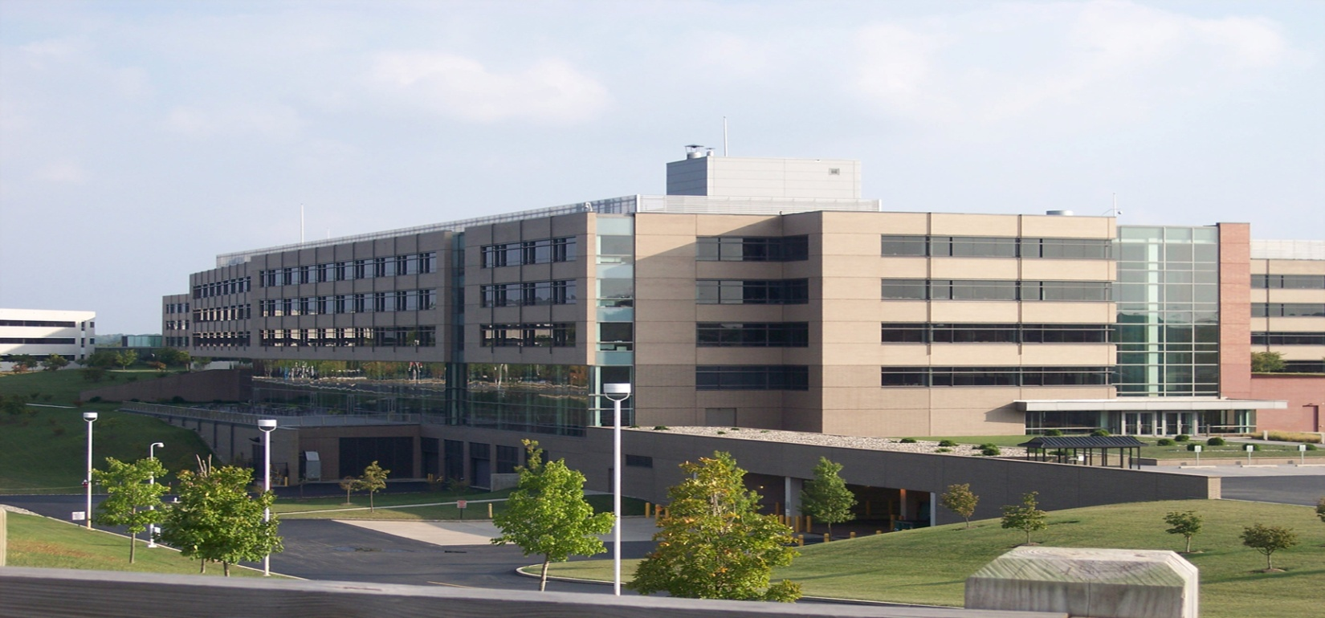
ADMINISTRATION BUILDING
Justin Purcell
Structural Option
Advisor: Dr. Hanagan

Slide 2
PRESENTATION OUTLINE
Building Background
Existing Structural System
Proposal
Proposed Structural System
Cost and Schedule Analysis
Electrical Redesign
Conclusions
Questions and Comments

Slide 3
PROJECT BACKGROUND

Slide 4
BUILDING INFORMATION
Owner: Confidential Client
Location: Pennsylvania
Building Type: Office and Specialty Amenity Spaces
Size: 311,905 S.F.
Stories: 5/4 Above Grade
F-F Height: 20’ For Ground Floor, 13.33’ For Floors 1-5
Building Height: 87’
Construction Dates: 10/22/01-7/24/03

Slide 5
KEY PLAYERS
Architect: KlingStubbins
CM: Skanska
Engineer: KlingStubbins

Slide 6
EXISTING STRUCTURAL SYSTEM

Slide 7
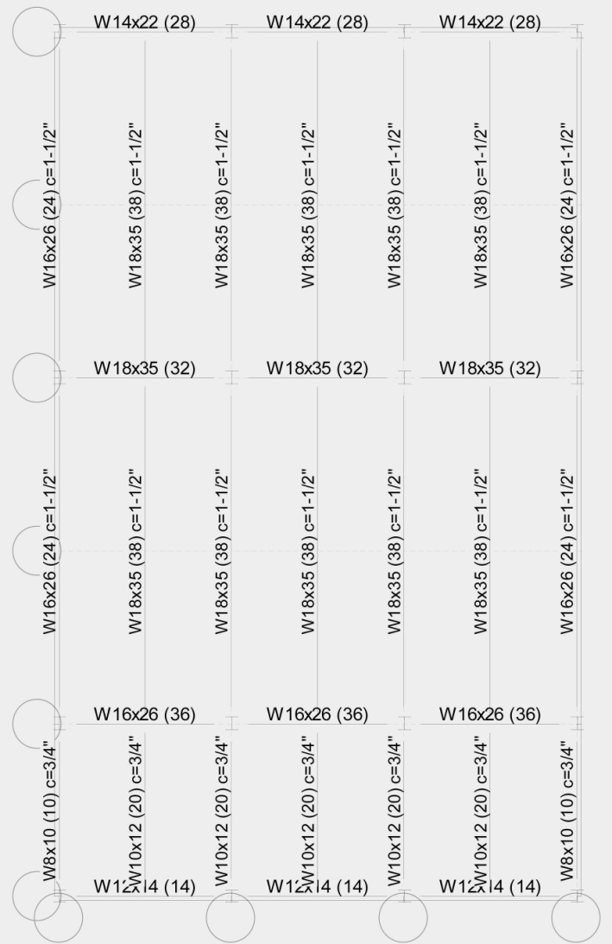
GRAVITY SYSTEM
3 ¼” Lightweight Concrete Slab,
4,000 PSI Concrete Strength
3” Composite Metal Deck
W18x35 Composite Beams-40’
W18x35 Composite Girders-20’
W12x96 Columns-13.33’

Slide 8
GRAVITY DESIGN LOADS
LIVE LOAD
FLOOR: | 100 PSF
ROOF: | 150 PSF
FLOOR DEAD LOAD
CONCRETE SLAB: | 35 PSF
SUPERIMPOSED: | 30 PSF
STEEL STRUCTURE | 15 PSF
EXTERIOR BRICK TRUSS PANEL | 40 PSF

Slide 9
TYPICAL FLOOR

Slide 10
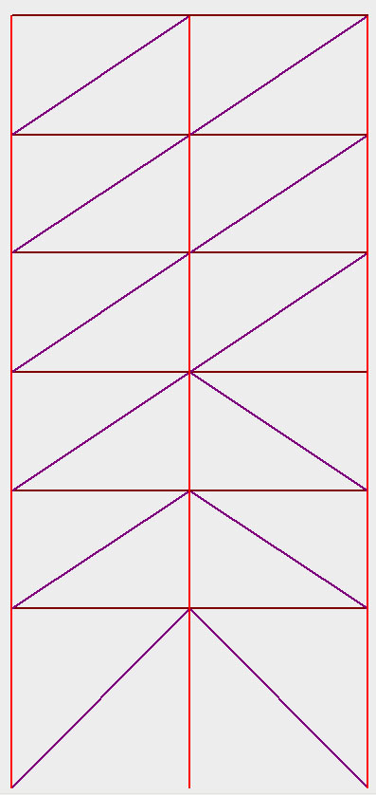
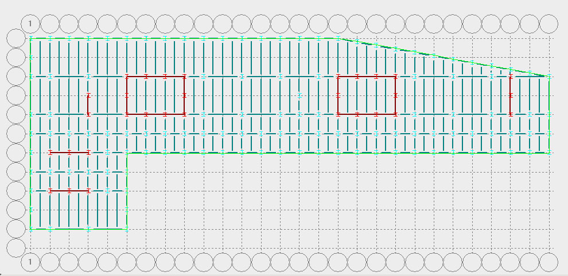
LATERAL SYSTEM
Braced Frames (Frames in Red)
HSS 8x6x½ Braces
Coordinated With Mechanical Distribution

Slide 11
BRACED FRAMES

Slide 12
PROPOSAL

Slide 13
GOALS
Change Existing Structural System To A One-Way Slab, CIP Concrete System
Estimate Cost Of Existing And Proposed Structural System
Estimate Schedule Of Both Systems
Redesign Electrical System To Limit The Number Of Transformers

Slide 14
STRUCTURAL REDESIGN

Slide 15
DESIGN PROCEDURE
ASCE 7-05
ACI 318-02
CRSI 2002 Design Manual
E-TABS
Unit Strip Method
PCA Slab And Column
Hand Calculations

Slide 16
STRUCTURAL OVERVIEW
6” Normal Weight Concrete Slab-CIP
16” x 28” CIP Beams
20” x 26” CIP Girders
20” x 30” CIP Columns
Moment Frames
Design Floor And Roof Loads:
DESIGN LIVE LOAD
FLOOR LOAD: | 100 PSF
ROOF LOAD: | 150 PSF
DESIGN DEAD LOAD
CONCRETE SLAB: | 88 PSF
SUPERIMPOSED: | 30 PSF

Slide 17
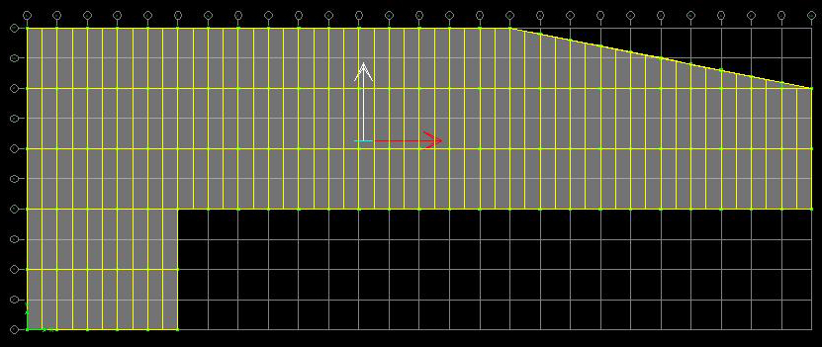
TYPICAL FLOOR

Slide 18
SLAB DESIGN
4000 PSI Concrete, 60 KSI Steel Reinforcing
Minimum 5” Thick Concrete Slab Based On ACI
6” Thick Concrete Slab Was Used
Pattern Loading Considered To Find Critical Moments
Steel Reinforcing
Bottom: #3’s @ 8” O/C (Positive)
Top: #4’s @ 12” O/C (Negative)
T-S: #4’s @ 15” O/C

Slide 19
COLUMN DESIGN
Designed For 1300 Kips and 750 K-FT
Gravity and Lateral Loads
Slenderness Considered Based On ACI For Lateral Loads
4000 PSI Concrete
# 3 Ties

Slide 20
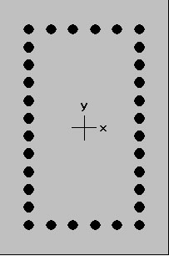
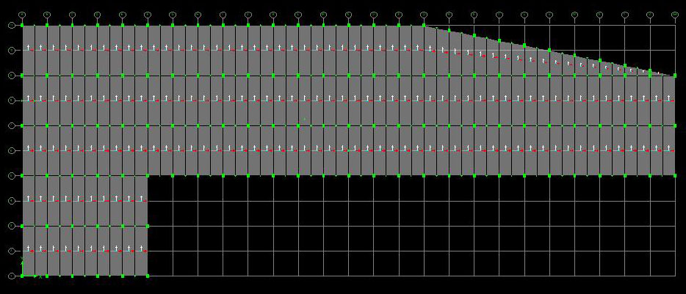
COLUMN DESIGN
20” x 30” CIP Column
32 #10 Bars
Oriented So That The 30” Depth Handles The Larger Wind Force In The Long Direction

Slide 21
BEAM DESIGN
Moment and Shear Coefficient Analysis
16” x 28” Beam
Steel Reinforcing
Bottom: 2 #11’s
Top: 2 #11’s
Stirrups: #5’s
L/370 Deflection Ratio

Slide 22
GIRDER DESIGN
Moment and Shear Coefficient Analysis
20” x 26” Girder
Steel Reinforcing
Bottom Bars: 3 #11’s
Top Bars: 4 #14’s
#5 Stirrups
L/706 Deflection Ratio

Slide 23
MOMENT FRAMES
Designed To Resist Lateral Loads In Both Directions
Achieved From CIP Monolithic Pour At Every Connection
For Simplicity Of Lateral System And Ease Of Construction, Every Column And Beam Connection Is A Moment Connection
Forces Distributed By Relative Stiffness
32 Moment Frames
6 In The Short Direction
26 In The Long Direction

Slide 24
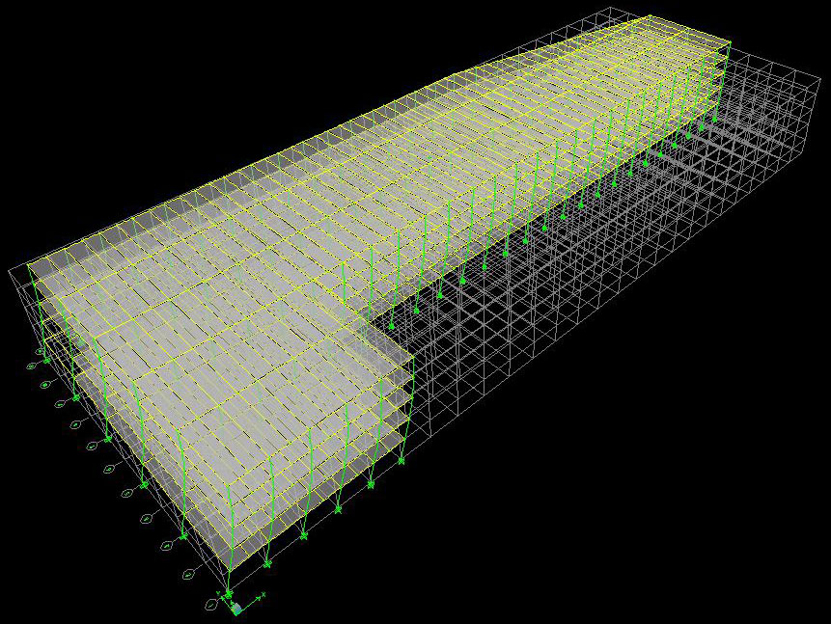
LATERAL DRIFT
Combination Of Shear Deflection And Bending Deflection
Controlled By Wind
Drift Found To Be Less
Than 1” In Both Directions
0.2” In Long Direction
0.15” In Short Direction

Slide 25
ADVANTAGES OVER EXISTING STRUCTURAL SYSTEM
Floor Depth Savings: 5”
Beam Deflection Savings: 0.7”
Girder Deflection Savings: 0.4”
# Of Column Savings: 76
Drift Savings: 0.37”

Slide 26
COST AND SCHEDULING

Slide 27
EXISTING STRUCTURAL SYSTEM
Cost Estimate #1: $8.62 Million
Estimate Based On G.C.’s Suggestions And Feedback
Cost Estimate #2: $7.71 Million
Estimate Based On R.S. Means 2008
Detailed Estimate Based On Takeoff Per L.F. Of Steel
Cost Estimate #3: $8.67 Million
Estimate Based On R.S. Means 2008
Generic Steel Estimate Based On A 3-6 Story Steel Building

Slide 28
EXISTING STRUCTURAL SYSTEM
Schedule For Estimate #1: N/A
Schedule For Estimate #2: 5 Months
Schedule For Estimate #3: 5 Months

Slide 29
PROPOSED STRUCTURAL SYSTEM
Cost Estimate #1: $13.46 Million
Based On R.S. Means 2008
Detailed Estimate Based On Takeoff
Cost Estimate #2: $12.44 Million
Based On R.S. Means 2008
Generic Estimate Based On CIP One-Way Slab W/Beams and Columns

Slide 30
PROPOSED STRUCTURAL SYSTEM
Schedule For Estimate #1: 15 Months
Schedule For Estimate #2: 15 Months

Slide 31
ELECTRICAL DESIGN

Slide 32
PROBLEM STATEMENT
There Is An Excessive Amount Of Transformers
Currently There Are 50 Transformers
GOALS:
Reduce Number Of Transformers
Resize The Feeders

Slide 33
PROBLEM STATEMENT

Slide 34
PROBLEM STATEMENT

Slide 35
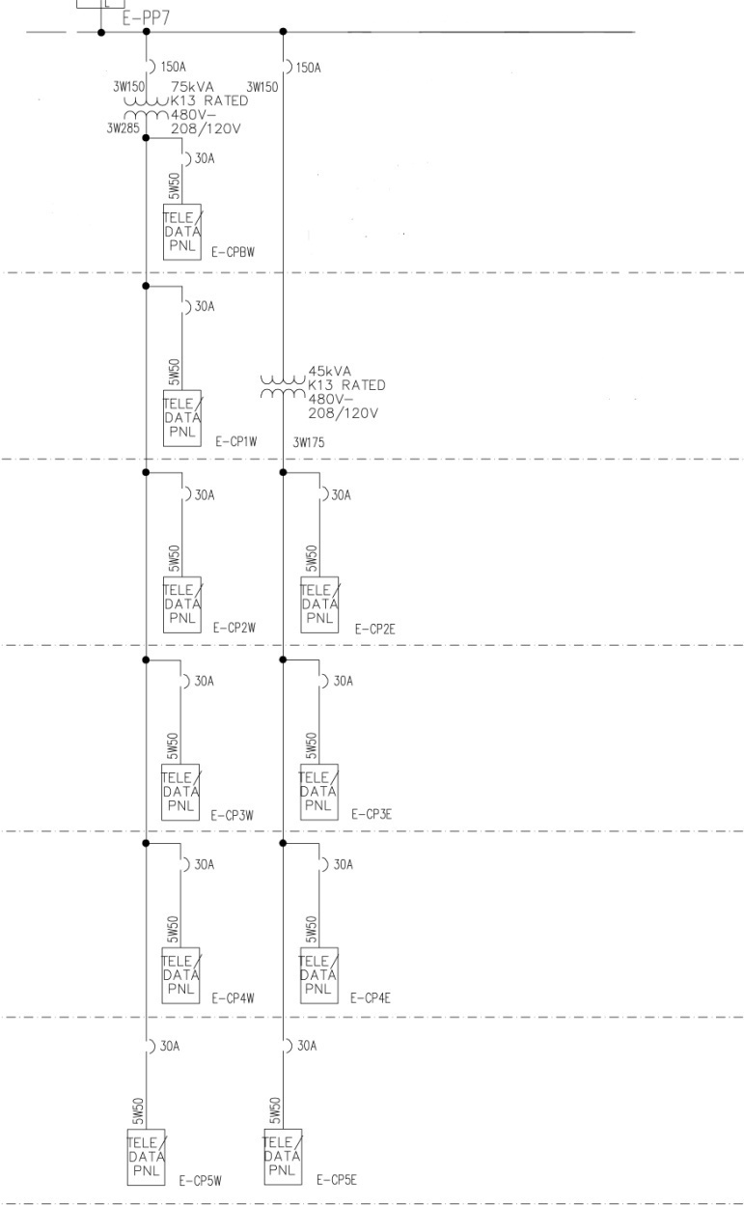
SOLUTION EXAMPLE
BEFORE:
AFTER:

Slide 36
SOLUTION EXAMPLE
LEFT SIDE:
Transformer Savings: 5
Connected Load: 53 KVA-Telecommunications
Replaced With 75 KVA Eaton 480V-208/120V
Replaced Feeder With 2 Sets Of 4 KcMil Wire

Slide 37
SOLUTION EXAMPLE
RIGHT SIDE:
Transformer Savings: 3
Connected Load: 35 KVA-Telecommunications
Replaced With 45 KVA Eaton 480V-208/120V
Replaced Feeder With 2 Sets Of 4 KcMil Wire

Slide 38
REDESIGN OVERVIEW
Transformers Before: 50
Transformers After: 11
Savings: 39
Utilized Eaton 480V-208/120V Transformers

Slide 39
RECOMMENDATION AND CONCLUSIONS

Slide 40
RECOMMENDATION
Keep Structural System As Steel Composite System With Braced Frames For The Following Reasons:
Cost
Erection Time

Slide 41
CONCLUSIONS
Initial Cost Analysis Was Proven Wrong
Recommend Keeping Existing Structural System
Able To Reduce The Number Of Electrical Transformers

Slide 42
ACKNOWLEDGEMENTS
KlingStubbins, Especially Bill Gillespie
Dr. Hanagan, Professor Parfitt And The Rest Of The AE Department
Ben Kovach At Balfour Beatty
Pennsylvania State University
Fellow AE’s
My Family And Friends

Slide 43
QUESTIONS AND COMMENTS

